Slide 1


Power BI Dashboard
UK Train Rides
“Final Project”

Slide 2

PPT下载 http://www.freeppt7.com/xiazai/
01
Project Overview
06
Removing Duplicates
02
Data Sources
07
Standardizing Columns
03
Initial Review
07
Creating calculated columns
04
Power Query Overview
09
Data Model Structure
05
Handling Missing Data
10
Relationships Explained
11
Dashboard Design Principles
CONTENTS
12
Journey Status& Reasons for Delay and cancel Dashboard
13
Filtering and Drilldowns
14
Preparing Files for GitHub
15
Uploading to GitHub
16
Conclusion & Future Work

Slide 3

01
Project Overview
Part One
This project explores UK train ride data using Power BI. It involves cleaning raw data, building a relational model, visualizing insights through interactive dashboards.
Notes:
Template from: https://www.freeppt7.com/

Slide 4
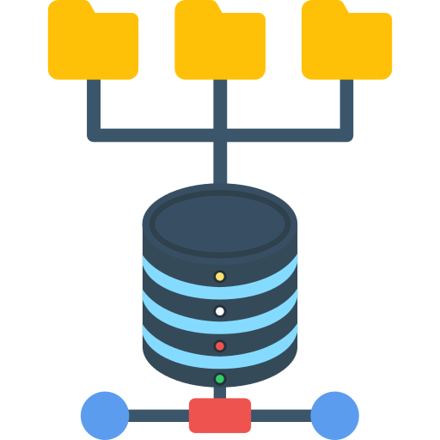
02
Data Sources
Part Two
The data originates from structured Excel files, containing train stations, ticket sales, and journey records. These files were imported into Power BI Desktop for further analysis and modeling tasks.
Notes:
Template from: https://www.freeppt7.com/

Slide 5

03
Initial Review
Part Three
Data review involved checking for missing fields, unexpected data types, and outliers. Understanding the structure and content was crucial for designing a clean, reliable, and insightful data model foundation.
Notes:
Template from: https://www.freeppt7.com/

Slide 6
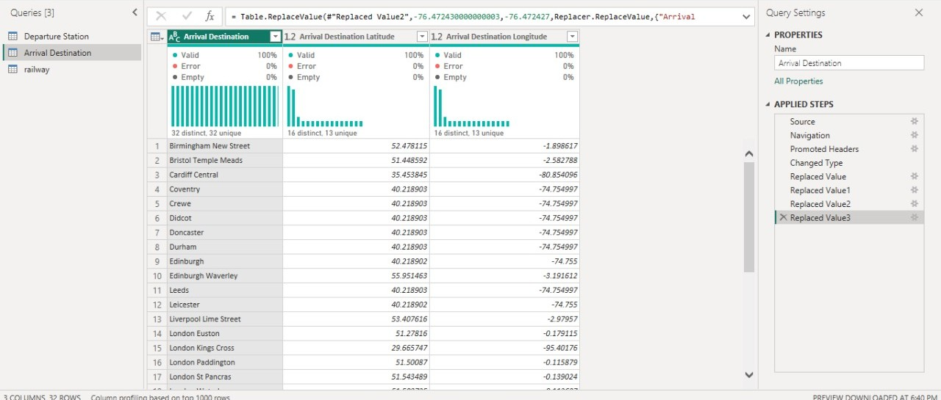
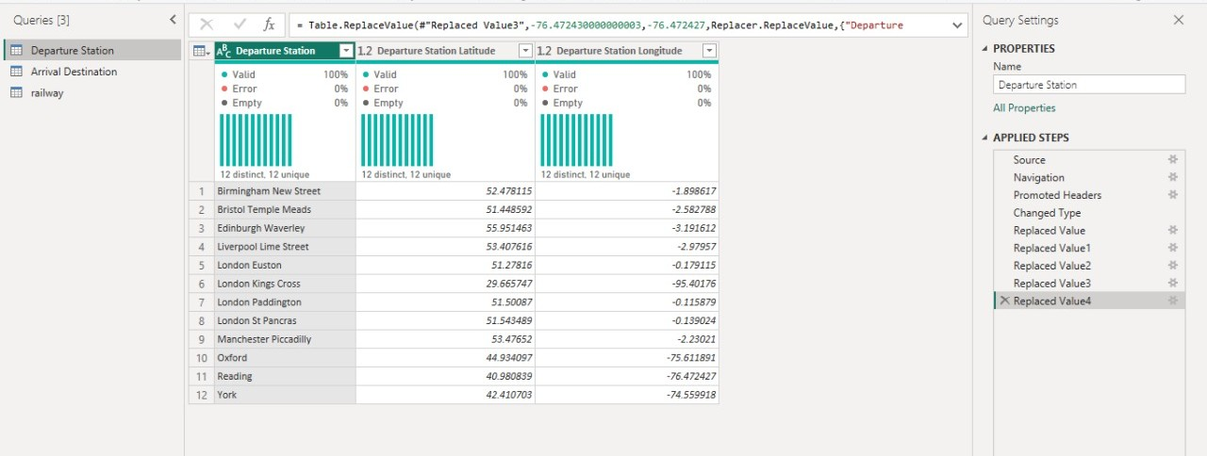
04 Power Query Overview
- Clean and transform the data - Each step—renaming columns. - Changing data types. - Filtering rows - Applied steps for easy traceability and reproducibility.
" Locating Train Stations– These Are Arrival Stations"
"Locating Train Stations – These Represent Departure Points"

Slide 7

05
Handling Missing Data
Part Five
Identified and handled by filling in with default values or removing incomplete rows. Ensuring completeness was key to maintaining data integrity and supporting meaningful analysis.
Notes:
Template from: https://www.freeppt7.com/

Slide 8

06
Removing Duplicates
Part Six
Duplicate records in stations and rides data were removed using Power Query's remove duplicate's function. *This ensured unique identifiers were preserved and data redundancy did not affect analysis outcomes.
Notes:
Template from: https://www.freeppt7.com/

Slide 9

07
Standardizing Columns
Part Seven
Ensured date formats, numerical units, and text entries were consistent. This step made downstream calculations and visualizations more reliable, enhancing overall clarity and report quality for decision-makers.
Notes:
Template from: https://www.freeppt7.com/

Slide 10
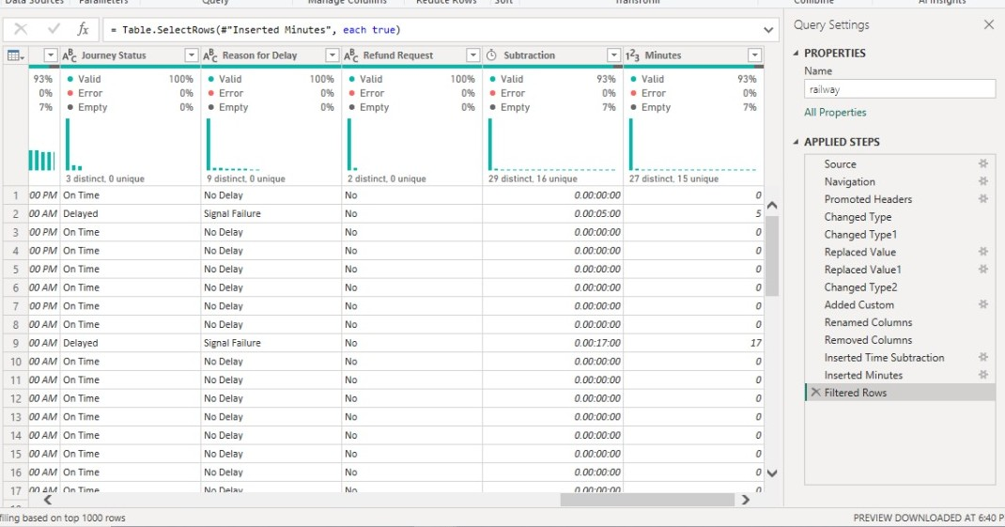
08 Creating Calculated Columns
DAX formulas were used to create new columns such as Trip Duration and Ticket Revenue. These derived fields helped summarize and categorize data in ways that drove better visual storytelling.

Slide 11

09
Data Model Structure
Part Nine
The model was structured as a star schema with fact tables (rides, tickets) and dimension tables (stations). Clear relationships made it easy to aggregate data across categories and time.
Notes:
Template from: https://www.freeppt7.com/

Slide 12
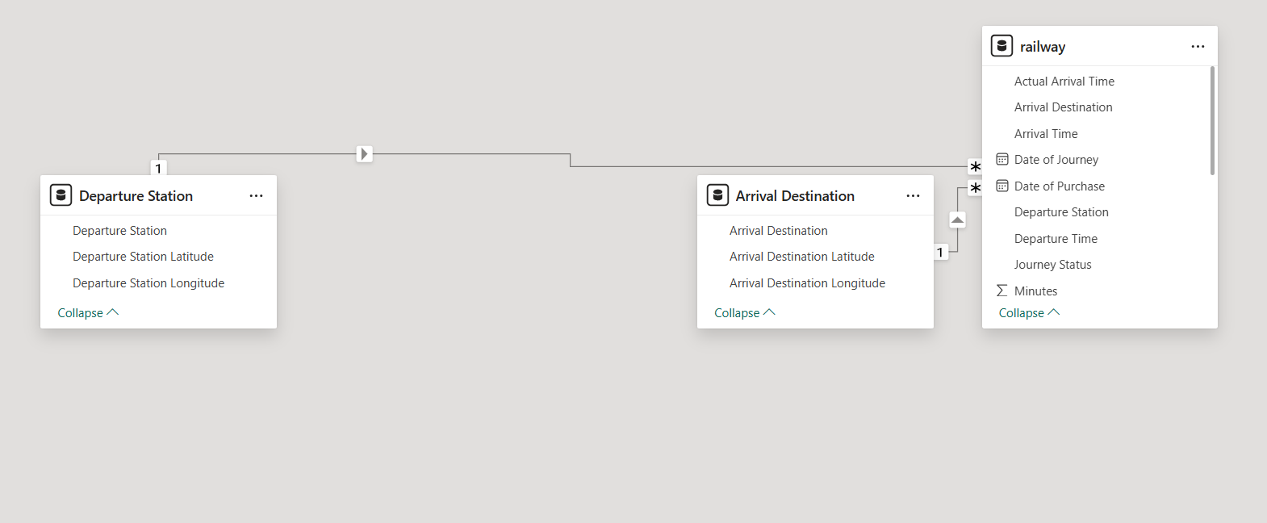
10 Relationships Explained
Relationships were built between tables using one-to-many links. For instance, each station could be related to many rides. Relationship directions and cardinality were carefully configured for accurate joins.

Slide 13
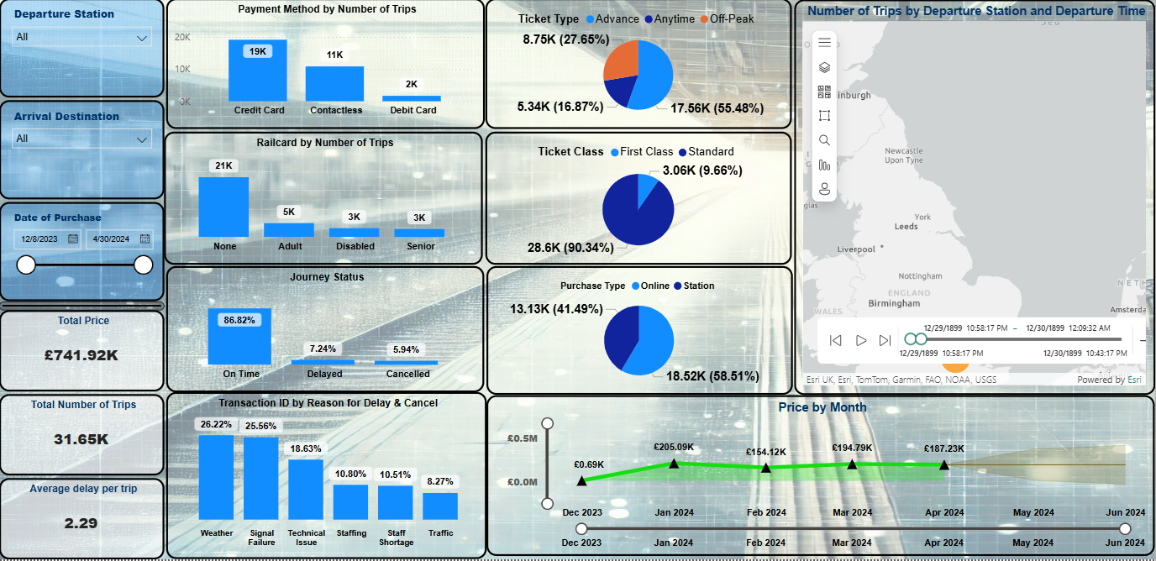
11 Dashboard Design Principles
Visual clarity, color consistency, and interactivity guided the dashboard design. Slicers, tooltips, and card visuals made it easy to navigate data and derive insights from different business perspectives.

Slide 14
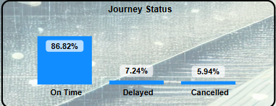
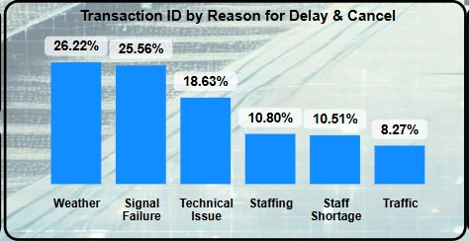
12 Journey Status & Reasons for Delay and cancel Dashboard
This dashboard showcases The journey punctuality, with 86.82% of trips arriving on time, 7.24% delayed, and 5.94% cancelled. This insight helps assess service reliability and identify areas for operational improvement.
Weather and signal failure were the leading causes of disruptions, followed by technical issues, staffing problems, and traffic. Understanding these factors supports better planning and operational efficiency

Slide 15

13
Filtering and Drilldowns
Thirteen
Interactive filters and drill-through pages allowed users to explore specific stations or time periods. These features made the dashboard dynamic, customizable, and suitable for deep-dive analysis sessions.
Notes:
Template from: https://www.freeppt7.com/

Slide 16

14
Preparing Files for GitHub
Fourteen
The PBIX file and supporting data sources were exported and organized. Documentation including project objectives, steps, and results were prepared to make the GitHub repository comprehensive and readable.
Notes:
Template from: https://www.freeppt7.com/

Slide 17
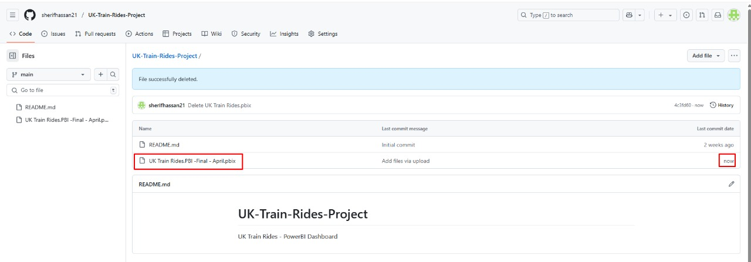
15 Uploading to GitHub
A repository was created on GitHub, where all files were uploaded. The README file documented each phase of the project, ensuring transparency and aiding future contributors or reviewers.

Slide 18

16
Conclusion & Future Work
Sixteen
The project successfully demonstrated end-to-end data handling. Future improvements could include automation, real-time data, or predictive analytics to further enhance the insights and impact of the dashboards.
Notes:
Template from: https://www.freeppt7.com/

Slide 19
Team Members
Mohamed Fathy
Abdullah Mantawy
Karim Zakaria
Sherif Hassan
Import the Excel data file into Power Query, perform the necessary data cleaning, and apply relevant functions to ensure the data is prepared for presentation.
Responsible for creating clear presentations and keeping documents well like Dataset file & Power BI Files and Upload the files to Github
Creating the Visualization and analysis the Dashboard
Creating the Visualization and analysis the Dashboard

Slide 20

THANKS

